Slide 1
420-D04-SU
Object-oriented programming I Java I
Programming in Java

Slide 2
Syntax / C++ comparison
Java uses the string concatenation operator: +
Java uses package and import statements. Equivalent to namespace and using namespace in C++.
Everything (all variables and methods) must be in a class.
Every piece of data is an Object (except for variables of primitive types).
Methods are always virtual (unless explicitly specified as final).
There are no prototypes. Methods are defined directly inside classes.
There are no pointers in Java.
There is no delete keyword in Java. The garbage collector automatically frees up memory.
You cannot successfully access a non-existent array element. Trying to do so will produce a NullPointerException.
There is no multiple inheritance. Instead we will use interfaces.

Slide 3
Primitive data types
Type | Meaning | Size (bytes) | Range of values
byte | Very short integer | 1 | −128 to +127
short | Short integer | 2 | −32 768 to +32 767
int | Integer | 4 | −2,147,483,648 to +2,147,483,647
long | Long integer | 8 | −9.223 × 10¹⁸ to +9.223 × 10¹⁸
float | Single-precision real number | 4 | ±1.40130 × 10⁻⁴⁵ to ±3.40282 × 10³⁸ Precision ≈ 7 decimal digits
double | Double-precision real number | 8 | ±4.94066 × 10⁻³²⁴ to ±1.79769 × 10³⁰⁸ Precision ≈ 16 decimal digits
boolean | Boolean logical value | 1 | true or false
char | Unicode character | 2 | ‘\u0000’ to ‘\uffff’ 0 to 65535

Slide 4
Variables
All variables that are not of a primitive data type are in fact essentially pointers: they contain a reference to an object that must be instantiated with new.
There are no global variables. All variables must be encapsulated within a class.
Default access modifier: package-private
Member variables default initialization: zero, false, null
Local variables have no default initialization, and must be initialized before being accessed.
There is no implicit casting where this could result in information loss.

Slide 5
The garbage collector (GC)
No more delete for deleting objects from memory.
It is the garbage collector that has the role of liberating memory when objects are no longer used.
To force the garbage collector:
System.gc();

Slide 6
The main method
At least one class must possess a static main method.
This method is the entry point of the program.
It must be static in so that it can be invoked from the class without needing to create an instance.
public class MyClass
{
public static void main(String[] args)
{
//code
}
}

Slide 7
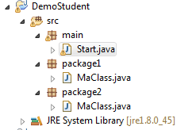
Packages
Java classes, interfaces, and enums are organized. We group these types together in packages.
These allow us to avoid name collision.

Slide 8
Packages
Packages also allow us to group a collection of types together and control access to them, and to their members.
package-private (default) allows free access from anywhere within the package but blocks access from anywhere outside the package
protected allows free access to a member from anywhere within the package and also from within any subclasses outside the package

Slide 9
Hello World console
Install JDK
Configure environment variables
Test whether java is visible
java -version (execute)
javac -version (compile)
In a text editor, create the file Start.java:
public class Start
{
public static void main(String[] args)
{
// output line of text in the console
System.out.println("Hello World");
}
}

Slide 10
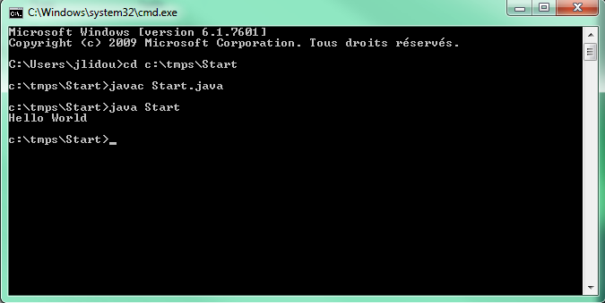
Hello World console
Windows command prompt window
javac Start.java
java Start
Displays: Hello World

